Slide 1
Riding habits of Cyclastic customers
March 12, 2022

Slide 2
Introduction
Cyclistic users fall into two categories:
Casual riders, who pay to rent bikes on an as-needed basis
Members, who pay a subscription fee for the service.
This report will examine the habits of both types of customers in an effort to determine best practices for converting more casual riders into paying members.

Slide 3
What this report will cover
Rentals by day
Length of rentals
Suggestions for action

Slide 4
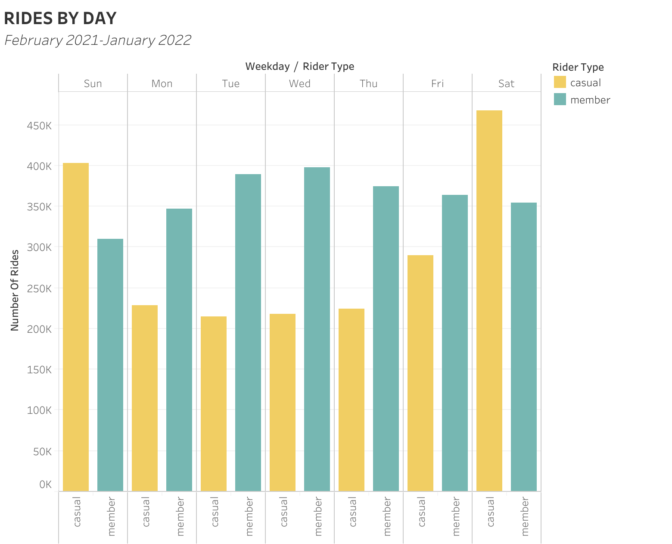
Rental habits
Casual riders take more trips on weekends.
Members ride more during the week.

Slide 5
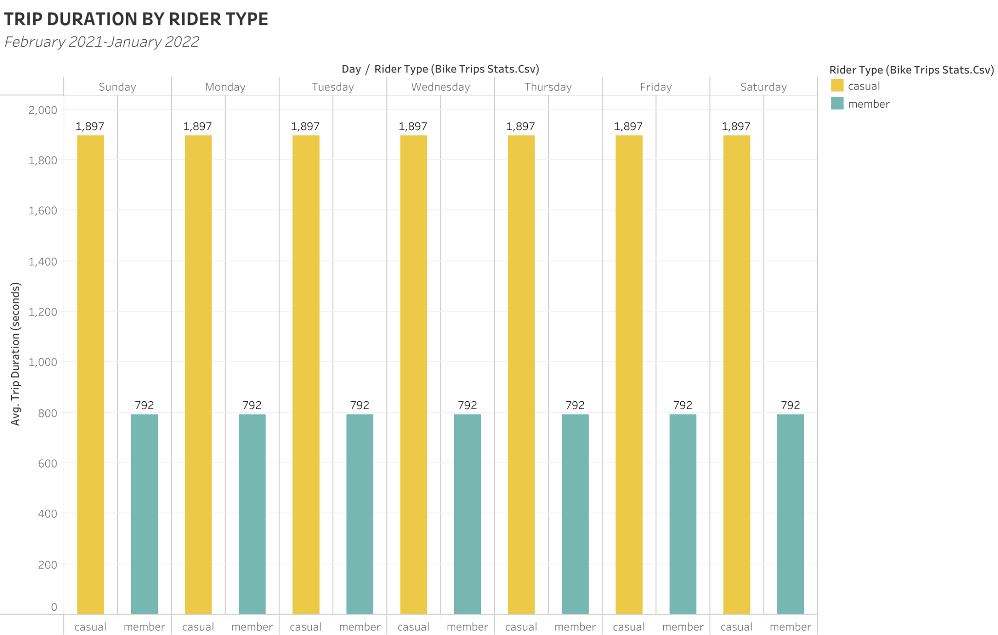
Rental habits (cont.)
Casual riders consistently use bikes longer than members do.

Slide 6
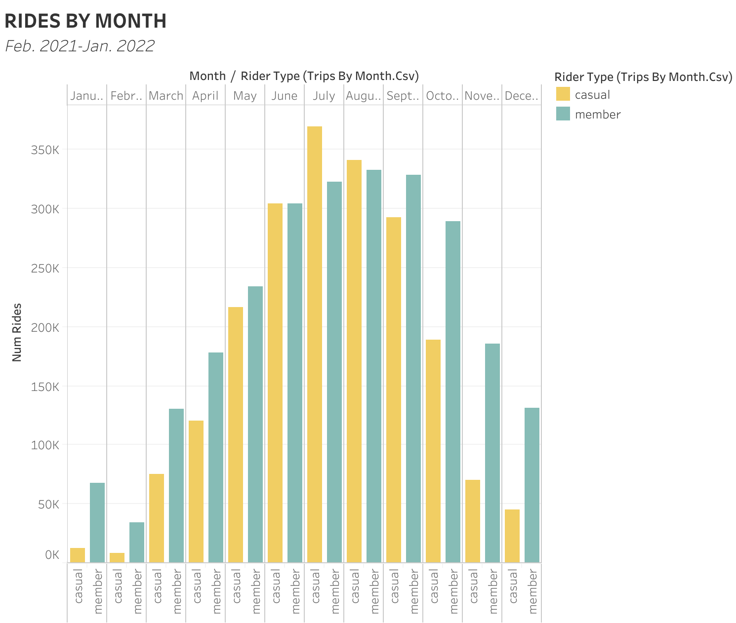
Rental habits (cont.)
Members take more trips than casual riders during the winter months (December, January, February.
In a surprise to no one, both casual riders and members ride more often in the summer.

Slide 7
Suggestions for action
Create a weekend membership rate for weekend casual riders.
Give an incentive for casual riders who go on longer trips to become members.

Slide 8
Questions/Discussion

